Slide 1

CRAPPING
RAINBOWS
WITH
PHONEGAP
ROB SPECTRE
@dN0t

Slide 2

I WANT YOU TO IMAGINE
A BETTER PLACE

Slide 3
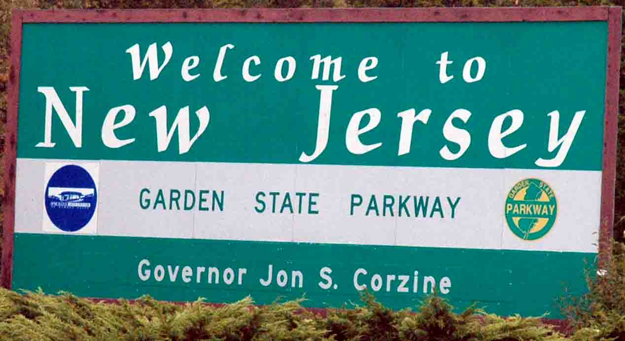
A PLACE FAR FROM THE
MOBILE WORLD YOU KNOW

Slide 4
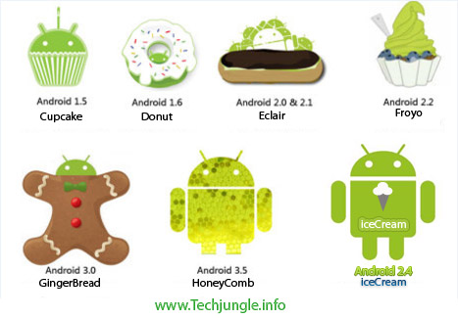
A WORLD FAR FROM
SDK VERSIONS

Slide 5
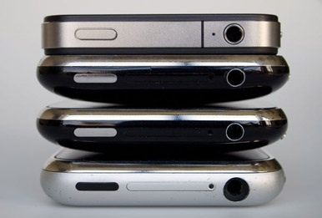
A WORLD FAR FROM
HARDWARE REVISIONS

Slide 6
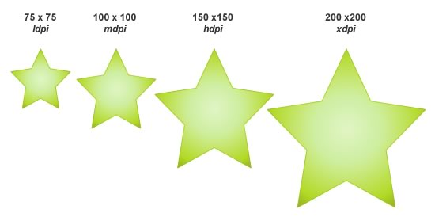
A WORLD FAR FROM
SCREEN DENSITIES

Slide 7

A WORLD WHERE
YOU DEPLOY ORDINANCE

Slide 8
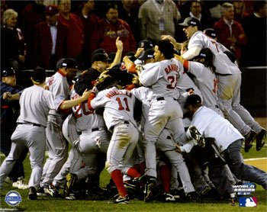
A WORLD WHERE
RED SOX ALWAYS WIN

Slide 9
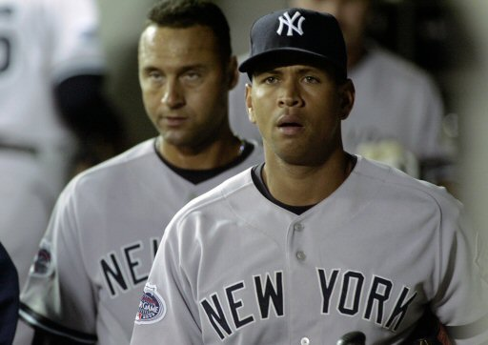
A WORLD WHERE
YANKEES ALWAYS LOSE

Slide 10

A WORLD WHERE
UNICORNS CRAP RAINBOWS

Slide 11
A WORLD CALLED
PHONEGAP-LAND. DRR.

Slide 12
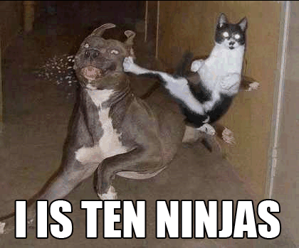
IS THIS GUY STILL
USING LOLCATS? (SRSLY)

Slide 13
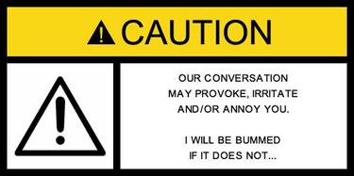
I BARELY KNOW WHAT
I'M TALKING ABOUT

Slide 14
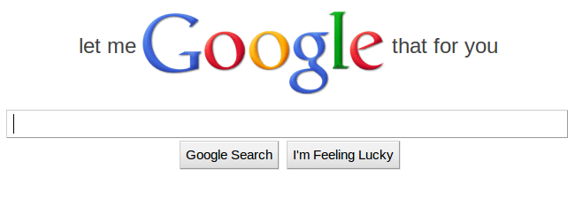
LET ME GOOGLE
A TALK FOR YOU

Slide 15

HOW DO WE
TASTE THE RAINBOW?

Slide 16

PHONEGAP IS NOT
SPONSORED BY GODADDY

Slide 17

PHONEGAP IS FOSS
LIKE A BOSS

Slide 18

WEB APPS THAT RUN
LIKE NATIVE APPS

Slide 19
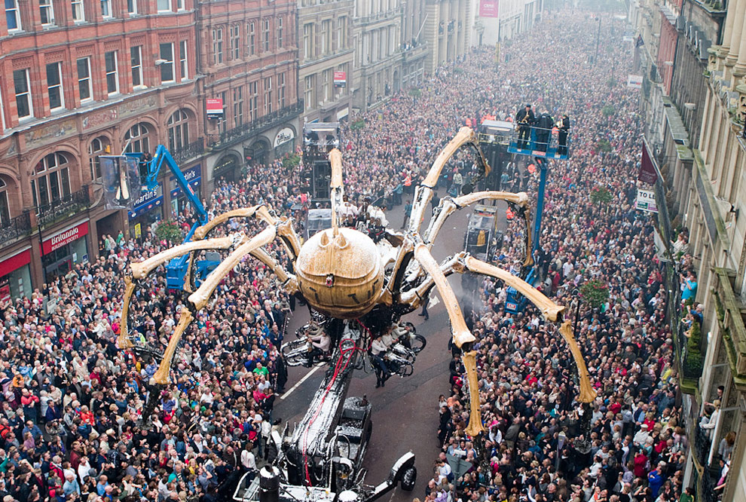
WAY MORE PEOPLE
INTO WEB

Slide 20

ONE CODE BASE
FOR ALL DEVICES

Slide 21

TESTING
ONLY BETTER AND CHEAPER

Slide 22
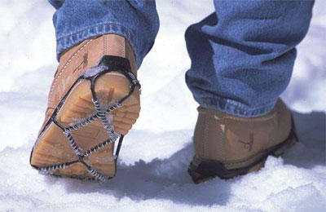
PHONEGAP HAS
GOT SOME TRACTION

Slide 23

APPROVED BY EVEN
THE SNOBIEST STORES

Slide 24

THIS LOGO IS
PRETTY CREEPY

Slide 25
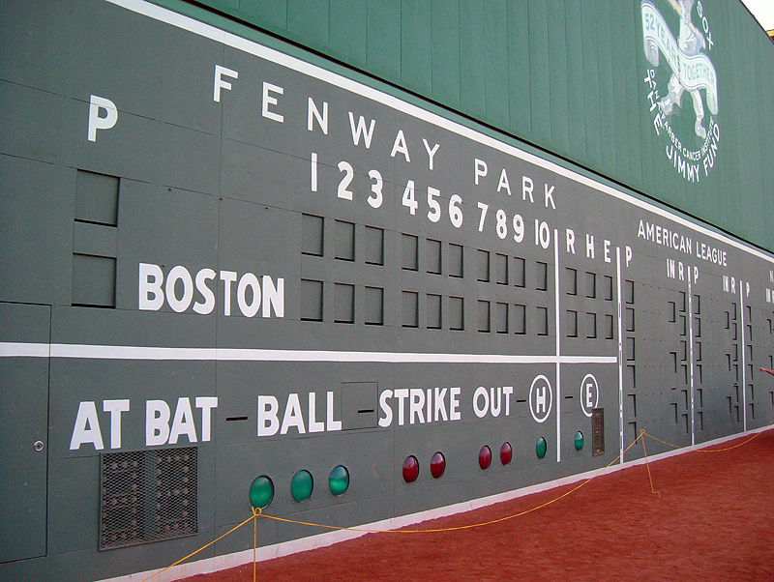
LIGHTING UP
THE SCOREBOARD

Slide 26

WRITE YOUR APP
HOWEVER YOU WANT

Slide 27

PHONEGAP MAKES
YOUR APP COMFY

Slide 28
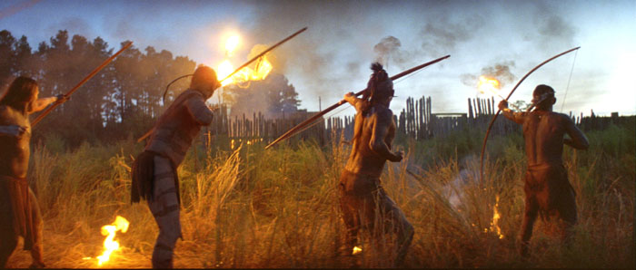
GET RAW NATIVE
BUTTKICKERY

Slide 29

BUILD YOUR APP
WITH BUZZWORDS

Slide 30

SCREW THIS HIPPIE NOISE
SHOW ME SOME CODE.

Slide 31
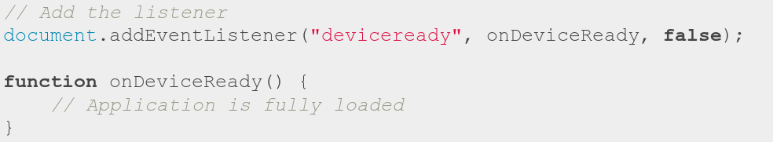
SCREW THIS HIPPIE NOISE
SHOW ME SOME CODE.

Slide 32
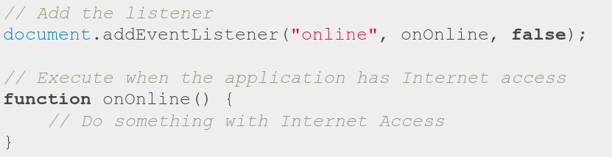
SCREW THIS HIPPIE NOISE
SHOW ME SOME CODE.

Slide 33
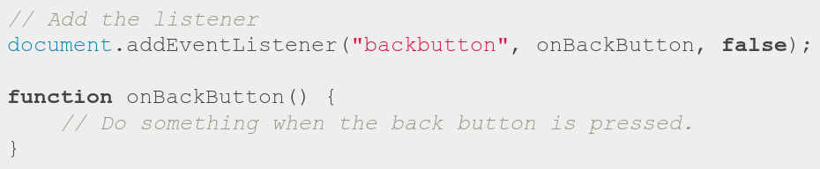
SCREW THIS HIPPIE NOISE
SHOW ME SOME CODE.

Slide 34
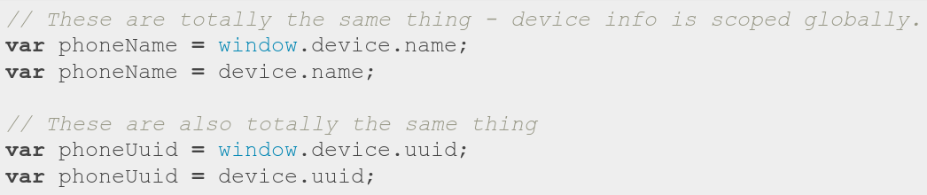
SCREW THIS HIPPIE NOISE
SHOW ME SOME CODE.

Slide 35
SCREW THIS HIPPIE NOISE
SHOW ME SOME CODE.

Slide 36
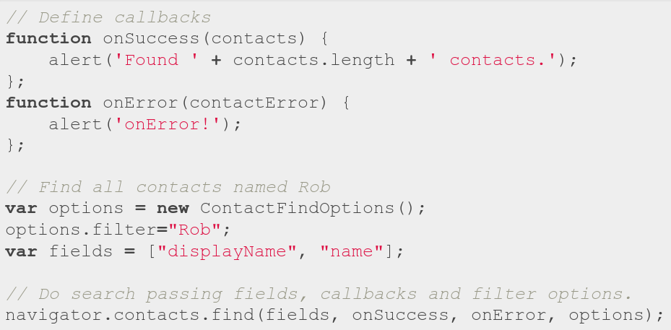
SCREW THIS HIPPIE NOISE
SHOW ME SOME CODE.

Slide 37
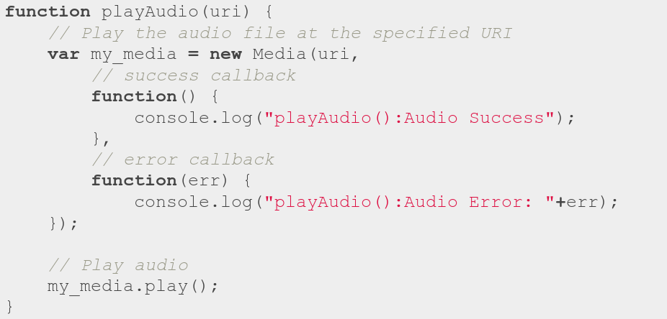
SCREW THIS HIPPIE NOISE
SHOW ME SOME CODE.

Slide 38
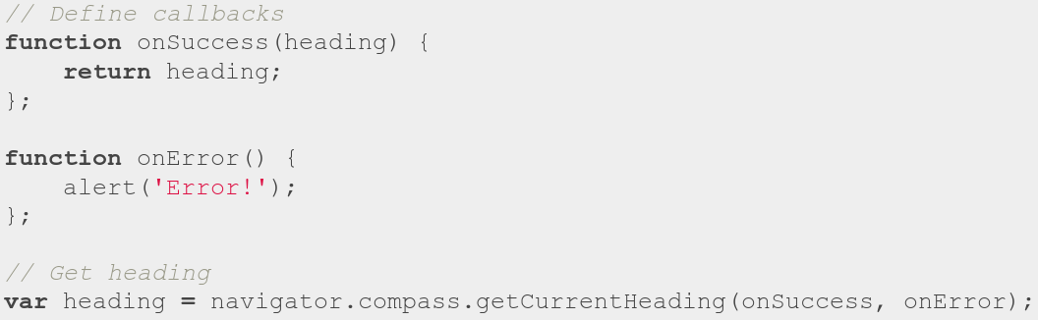
SCREW THIS HIPPIE NOISE
SHOW ME SOME CODE.

Slide 39
SCREW THIS HIPPIE NOISE
SHOW ME SOME CODE.

Slide 40

YOUR HEAD
ASPLODE

Slide 41
ADD .COM
AND WIN

Slide 42

A LITTLE BIRD
THAT DOESN'T GO TWEET

Slide 43

A GREAT RESOURCE
FOR GREAT PENGUINS

Slide 44
GITHUB.COM/RobSpectre/Talks
@dN0t
#PHONEGAP
ABOUT.ME
/rob.spectre

Slide 45
THANK
YOU!

Slide 46
QUES TIONS?

